Slide 1
Introduction to Artificial Intelligence (AI)
Instructor: Dr. Wei Ding

Slide 2
Humankind →Homo Sapiens
Homo sapiens (Latin: "wise man") is the binomial nomenclature (also known as the scientific name) for the only extant human species.
The field of artificial intelligence, or AI, attempts to understand intelligent entities. Thus, one reason to study it is to learn more about ourselves.

Slide 3
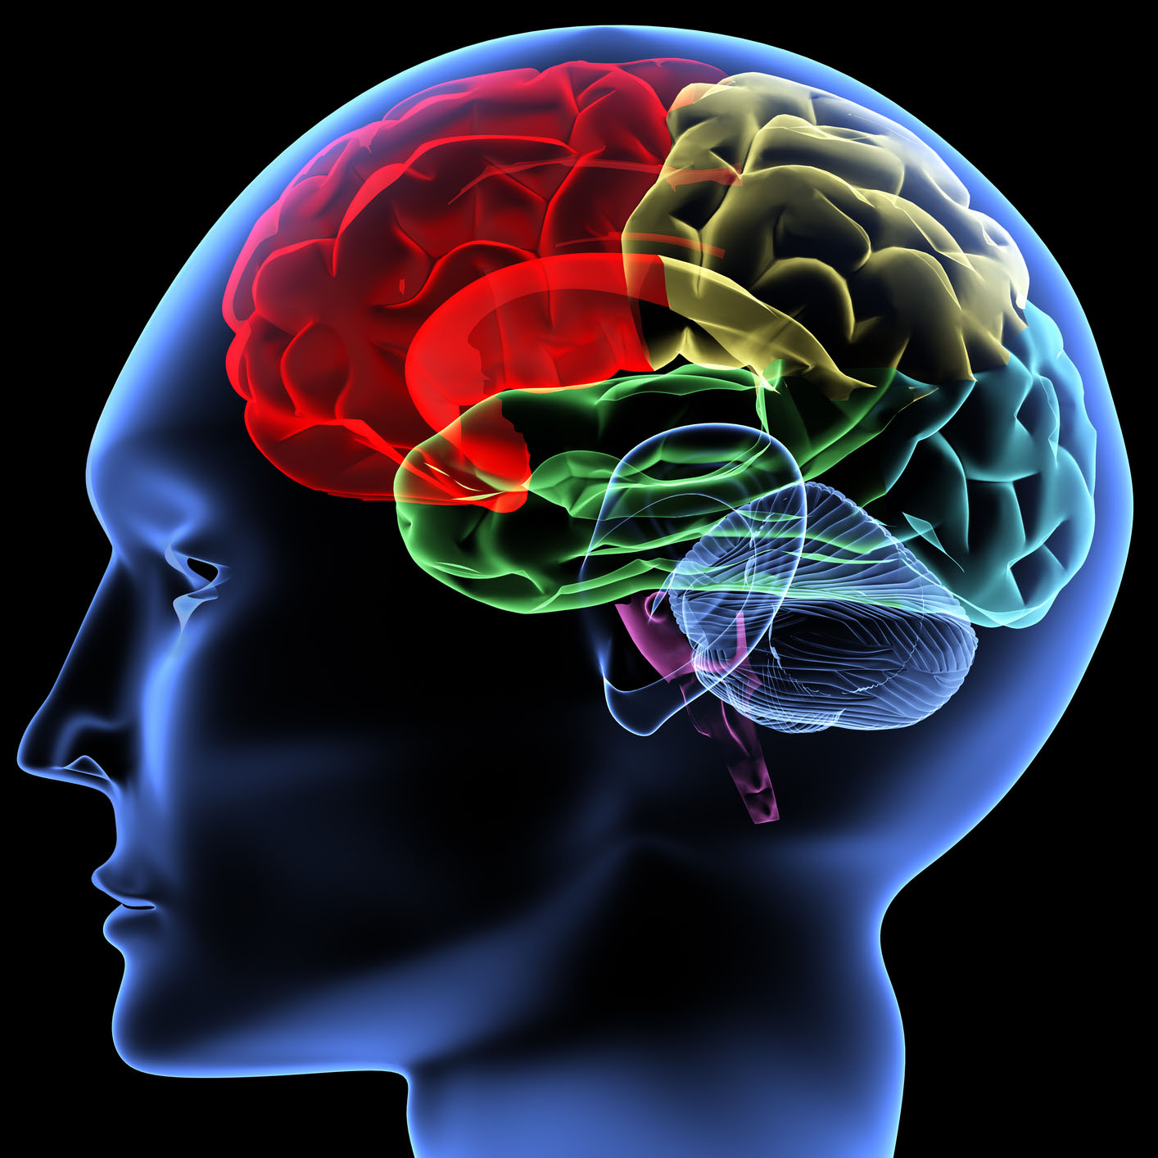
AI addresses one of the ultimate puzzles
How is it possible for a slow, tiny brain, whether biological or electronic, to perceive, understand, predict, and manipulate a world far larger and more complicated than itself?
How do we go about making something with those properties?

Slide 4
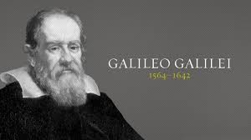
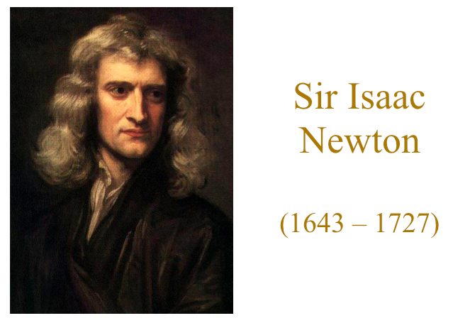
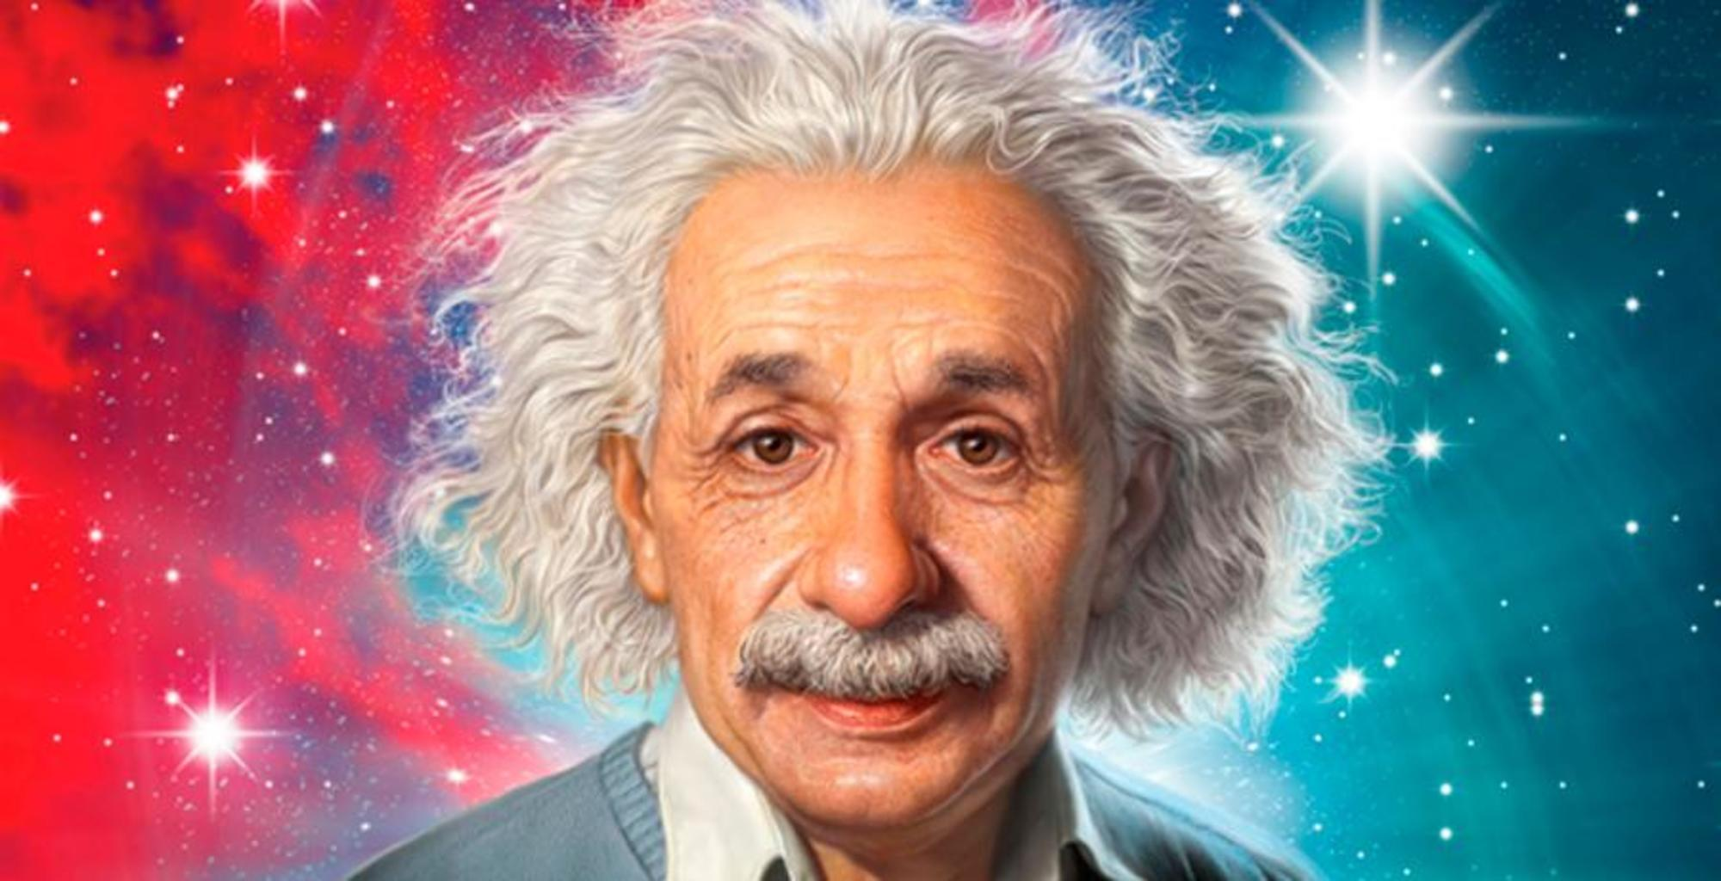
AI is one of the newest disciplines
All the good ideas in physics
have already been taken
AI, on the other hand, still has openings for a full-time Einstein.
you

Slide 5
AI is also one of the oldest disciplines
For over 2,000 years, philosophers have tried to understand how seeing, learning, remembering, and reasoning could, or should, be done.
AI currently encompasses a huge variety of subfields, from general-purpose areas such as perception and logical reasoning, to specific tasks such as playing chess, proving mathematical theorems, writing poetry, and diagnosing diseases.
Workers in AI can choose to apply their methods to any area of human intellectual endeavor. In this sense, it is truly a universal field.

Slide 6
What is Artificial Intelligence?
Views of AI fall into four categories:
The textbook advocates "acting rationally“
A rationalist approach involves a combination of mathematics and engineering.
Thinking Humanly
Thinking Rationally
Human performance:
hypothesis &
experimental
confirmation
An ideal concept
of intelligence:
Mathematics & engineering
Acting Humanly
Acting Rationally
Notes:
AI attempts not just to understand how we think but also to build intelligent entities.
AI is one of the newest sciences.
The definitions on the left measure success in terms of fidelity to human performance, whereas the ones on the right measure against an ideal concept of intelligence, which we will call rationality.
A human-centered approach must be an empirical science, involving hypothesis and experimental confirmation. A rationalist approach involves a combination of mathematics and engineering.

Slide 7
A Human-Centered Approach
Measure success in terms of human performance
A human-centered must be an empirical science involving hypothesis and experimental conformation
Thinking Humanly
Acting Humanly
Notes:
AI attempts not just to understand how we think but also to build intelligent entities.
AI is one of the newest sciences.
The definitions on the left measure success in terms of fidelity to human performance, whereas the ones on the right measure against an ideal concept of intelligence, which we will call rationality.
A human-centered approach must be an empirical science, involving hypothesis and experimental confirmation. A rationalist approach involves a combination of mathematics and engineering.

Slide 8
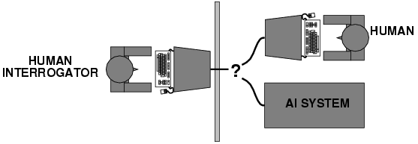
Acting humanly: Turing Test
The computer passes the test if a human interrogator, after posing some written questions, cannot tell whether the written responses from a person or not.
However,
Notes:
Turing test proposed by Alan Turing in 1950
Provide a satisfactory operational definition of intelligence
Indistinguishability from undeniably intelligent entities – human beings
No physical interaction. Physical simulation is unnecessary for intelligence.

Slide 9
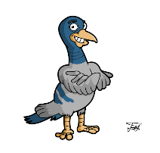
Acting humanly: Turing Test
Yet AI researchers have devoted little effort to passing the Turing test, believing that it is more important to study the underlying principles of intelligence than to duplicate an exemplar.
The quest for “artificial flight” succeeded when the Wright brothers and others stopped imitating birds and learned about aerodynamics.
Aeronautical engineering tests do not define the goal of their field as making “machines that fly so exactly like pigeons that they can fool even other pigeons.”

Slide 10
Acting humanly: Turing Test
To pass the Turing Test, the computer would need to possess the following capabilities:
Natural language processing to enable it to communicate successfully in English
Knowledge representation to store what it knows or hears
Automated reasoning to use the stored information to answer questions and to draw new conclusions
Machine learning to adapt to new circumstances and to detect and extrapolate patterns
Computer vision to perceive objects
Robotics to manipulate objects and move about
Notes:
Total turing test: computer vision and robotics.

Slide 11
Thinking humanly: cognitive modeling
Comparison of the trace of computer program reasoning steps to traces of human subjects solving the same problem.
Cognitive Science brings together computer models from AI and experimental techniques from psychology to try to construct precise and testable theories of the working of the human mind.
Now distinct from AI
AI and Cognitive Science fertilize each other in the areas of vision and natural language.
Notes:
To determine how human think.

Slide 12
A Rationalist Approach
A rationalist approach involves a combination of mathematics and engineering.
Thinking Rationally
Acting Rationally
Notes:
AI attempts not just to understand how we think but also to build intelligent entities.
AI is one of the newest sciences.
The definitions on the left measure success in terms of fidelity to human performance, whereas the ones on the right measure against an ideal concept of intelligence, which we will call rationality.
A human-centered approach must be an empirical science, involving hypothesis and experimental confirmation. A rationalist approach involves a combination of mathematics and engineering.

Slide 13
Thinking rationally: "laws of thought"
The Greek philosopher Aristotle was one of the first to attempt to codify “right thinking.”
His syllogisms provided patterns for argument structures that always yielded correct conclusions when given correct premises.
For example, “Socrates is a man; all men are mortal; therefore, Socrates is mortal.” → initiated the field called logic.
Two main obstacles:
It is not easy to take informal knowledge and state it in the formal terms required by logical notation, particularly when the knowledge is less than 100% certain.
There is a big difference between being able to solve a problem “in principle” and doing so in practice.
Notes:
Even problems with just a few dozen facts can exhaust the computational resources of any computer unless it has some guidance as to which reasoning steps to try fist.

Slide 14
The challenge of Logic Reasoning
Even problems with just a few dozen facts can exhaust the computational resources of any computer unless it has some guidance as to which reasoning steps to try fist.

Slide 15
Machine Learning Definition
Arthur Samuel (1959). Machine Learning: Field of study that gives computers the ability to learn without being explicitly programmed.
A Computer Checker Game: Arthur Samuel managed to write a checkers program that could play checkers much better than he personally could, and this is an instance of maybe computers learning to do things that they were not programmed explicitly to do.
We will learn alpha-beta pruning and minimax strategy designed by Samuel later in the semester.

Slide 16
Another more modern definition of Machine Learning
Tom Mitchell: A computer program is set to learn from an experience E with respect to some task T and some performance measure P if its performance on T as measured by P improves with experience E.
For example, in the case of checkers, the experience E that a program has would be the experience of playing lots of games of checkers against itself. The task T is the task of playing checkers, and the performance measure P will be something like the fraction of games it wins against a certain set of human opponents. And by this definition, we'll say that Arthur Samuel's checkers program has learned to play checkers

Slide 17
Acting rationally: rational agent
Rational behavior: doing the right thing
The right thing: that which is expected to maximize goal achievement, given the available information
We will concentrate on general principles of rational agents and on components for constructing them.
Achieving perfect rationality – always doing the right thing – is not feasible in complicated environments.
Limited rationality – acting appropriately when there is not enough time to do all the computations one might like.
Notes:
A rational agent is one that acts so as to achieve the best outcome or, when there is uncertainty, the best expected outcome.

Slide 18
Rational agents
An agent is an entity that perceives and acts.
Abstractly, an agent is a function from percept histories to actions:
[f: P* → A]
For any given class of environments and tasks, we seek the agent (or class of agents) with the best performance.
Caveat: computational limitations make perfect rationality unachievable:
→ design best program for given machine resources

Slide 19
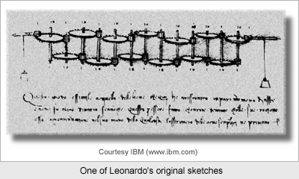
The foundations of AI
Philosophy (428 B.C. – present): Logic, methods of reasoning, mind as physical system foundations of learning, language, rationality
Aristotle (384-322 B.C.) developed an informal system of syllogism for proper reasoning, which in principle allowed one to generate conclusions mechanically, given initial premises.
The automation of computation. Leonardo da Vinci (1452-1519) designed a mechanical calculator
Notes:
Rational part of the mind

Slide 20
The foundations of AI
Mathematics (c. 800 – present): mathematical formalization in logic, computation, and probability.
Intractability: a problem is called intractable if the time required to solve instances of the program grow exponentially with the size of the instance.
NP-completeness: Nondeterministic Polynomial time complete.
The most notable characteristic of NP-complete problems is that no fast solution to them is known
An expert programmer should be able to recognize an NP-complete problem so that he or she does not unknowingly waste time trying to solve a problem
Notes:
NP-complete (abbreviated NP-C or NPC) is a class of related problems in computer science. For these problems, a solution can be checked quickly on an ordinary computer (i.e. they are in NP). It is not known whether these problems can be solved quickly (i.e. whether they are in P). But, if even one of these problems can be solved quickly, then every problem in NP can be solved quickly.
The most notable characteristic of NP-complete problems is that no fast solution to them is known; that is, the time required to solve the problem using any currently known algorithm increases very quickly as the size of the problem grows. As a result, the time required to solve even moderately large versions of many of these problems easily reaches into the billions or trillions of years, using any amount of computing power available today. As a consequence, determining whether or not it is possible to solve these problems quickly is one of the principal unsolved problems in Computer Science today.
While a method for computing the solutions to NP-complete problems using a reasonable amount of time remains undiscovered, computer scientists and programmers still frequently encounter NP-complete problems. An expert programmer should be able to recognize an NP-complete problem so that he or she does not unknowingly waste time trying to solve a problem which so far has eluded generations of computer scientists. Instead, NP-complete problems are often addressed by using approximation algorithms in practice.

Slide 21
The foundations of AI
Economics (1776-present): utility, decision theory
Utility: how people make choices that lead to preferred outcomes.
Decision theory & game theory: how should we do this when others may not go along.
Neuroscience (1861-present): How do brains process information?
Psychology (1879-present): How do humans and animals think and act?
Computer engineering (1940-present): How can we build an efficient computer?
Control theory and cybernetics (1948-present): How can artifacts operate under their own control?

Slide 22
The foundations of AI
Linguistics (1957-present): How does language relate to thought?
Computational linguistics or natural language processing.
knowledge representation: the study of how to put knowledge into a form that a computer can reason with.

Slide 23
Abridged history of AI
13 years
1943-1955: The gestation of artificial intelligence
1956: The birth of artificial intelligence: The Dartmouth workshop
1952-1969: Early enthusiasm, great expectations
1966-1973: A dose of reality, AI discovers computational complexity
1969-1979: Early development of knowledge-based systems
1980: AI becomes an industry
1987: AI becomes a science: to be accepted, hypotheses must be subjected to rigorous empirical experiments, and the results must be analyzed statistically for their importance.
1995:The emergence of intelligent agents: understand the workings of agents embedded in real environments with continuous sensory inputs.
2001-Present: The ability of very large data sets: worry about the data and less picky about what algorithm to apply.
Notes:
1943-1955: : knowledge of the basic physiology and function of neurons in the brain; a formal analysis of propositional logic; Turing’s theory of computation

Slide 24

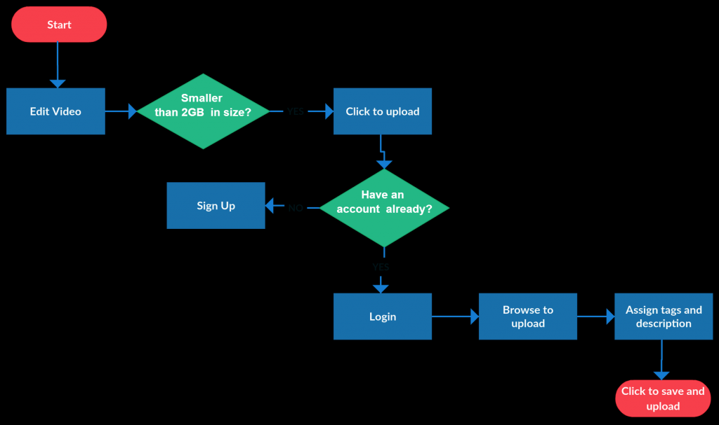

Slide 25



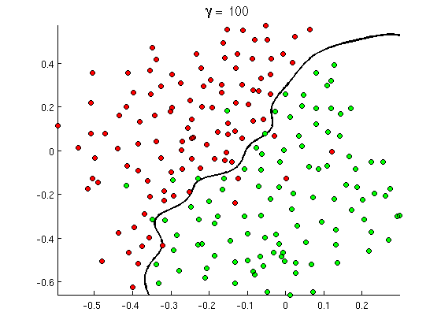
Data

Slide 26
State of the art
Self-Driving Cars: computer vision + machine learning; navigate safely without human intervention; Tesla, Waymo, and Uber.
Healthcare Diagnostics: medical image analysis + drug discovery, disease prediction.
Natural Language Processing: Understand and generate human-like text; ChatGPT, BERT.
Robotics: AI-powered robots; Boston Dynamics and Intuitive Surgical
Deepfake Technology: raises ethical concerns; allowing for highly convincing manipulation of audio and video content
Notes:
Not magic or science fiction
Science, engineering, and mathematics, to which the book provides an introduction.

Slide 27

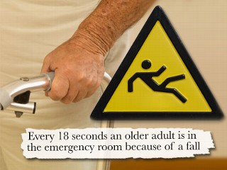

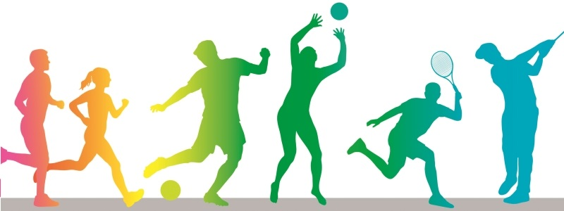

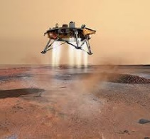

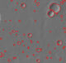
Knowledge Discovery Lab
Crime Forecasting
Physical Activity Classification
Older adults fall
Wet Chemistry Lab Data Analysis
Long-lead Extreme Flooding Events Forecasting
Crater Detection from Planetary Images
Clinical Trials

